Slide 1
CS101 Algorithms and Data Structures
Reductions, P and NP
Notes:
Adapted from http://www.cs.princeton.edu/~wayne/kleinberg-tardos

Slide 2
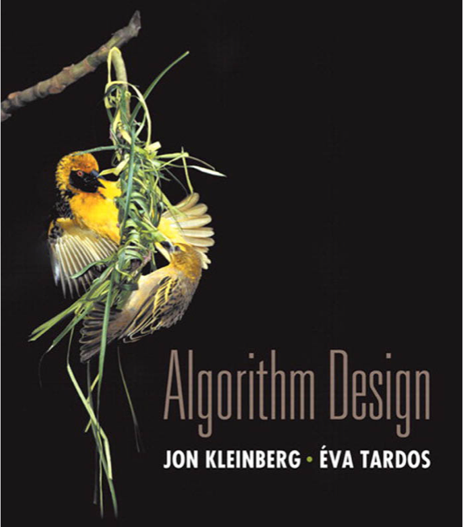

Reductions, P and NP
poly-time reductions
packing and covering problems
constraint satisfaction problems
graph coloring
P vs. NP
NP-complete
Section 8.1

Slide 3
Algorithm design patterns and antipatterns
Algorithm design patterns.
Greedy.
Divide and conquer.
Dynamic programming.
Reductions.
Duality.
Local search.
Randomization.
Algorithm design antipatterns.
NP-completeness. O(n^{k}) algorithm unlikely.
PSPACE-completeness. O(n^{k}) certification algorithm unlikely.
Undecidability. No algorithm possible.

Slide 4

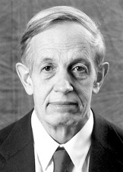
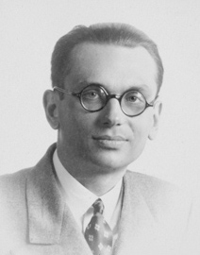
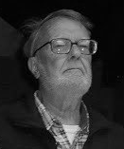
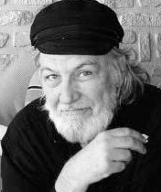

Classify problems according to computational requirements
Q. Which problems will we be able to solve in practice?
A working definition. Those with poly-time algorithms.
Theory. Definition is broad and robust.
Practice. Poly-time algorithms scale to huge problems.
von Neumann
(1953)
Nash
(1955)
Gödel
(1956)
Cobham
(1964)
Edmonds
(1965)
Rabin
(1966)
Turing machine, word RAM, uniform circuits, …
constants tend to be small, e.g., 3 n ²
Notes:
huge gulf between polynomial and exponential algorithms.
poly-time: if you double the size of the input, the time to solve a problem doubles or triples or grows by some fixed rate
Closed under addition, multiplication, composition
poly-time on a TM is the same as poly-time on a word RAM since you can simulate one on the other with at most a poly blowup in running time

Slide 5
Classify problems according to computational requirements
Q. Which problems will we be able to solve in practice?
A working definition. Those with poly-time algorithms.
yes | probably no
shortest path | longest path
min cut | max cut
2-satisfiability | 3-satisfiability
planar 4-colorability | planar 3-colorability
bipartite vertex cover | vertex cover
matching | 3d-matching
primality testing | factoring
linear programming | integer linear programming
Notes:
sometime line between problems for which we know of poly-time algorithms and those with which we don’t is rather thin.

Slide 6
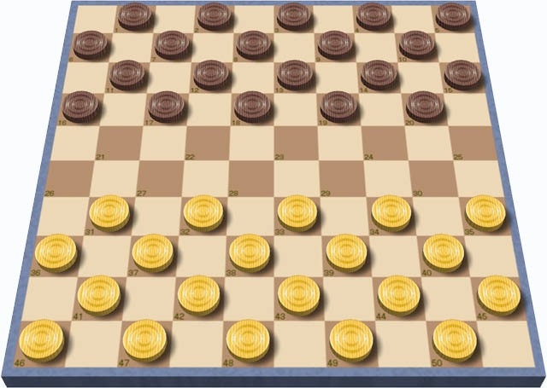
Classify problems
Desiderata. Classify problems according to those that can be solved in polynomial time and those that cannot.
Provably requires exponential time.
Given a constant-size program, does it halt in at most k steps?
Given a board position in an n-by-n generalization of checkers, can black guarantee a win?
Frustrating news. Huge number of fundamental problems have defied classification for decades.
input size = c + log k
using forced capture rule

Slide 7
Poly-time reductions
Desiderata′. Suppose we could solve problem Y in polynomial time. What else could we solve in polynomial time?
Reduction. Problem X polynomial-time (Cook) reduces to problem Y if arbitrary instances of problem X can be solved using:
Polynomial number of standard computational steps, plus
Polynomial number of calls to oracle that solves problem Y.
computational model supplemented by special piece of hardware that solves instances of Y in a single step
instance I (of X)
Algorithm for Y
solution S to I
Algorithm for X
Notes:
Cook reduction = polynomial time Turing reduction
Karp reduction = polynomial many-one reduction = polynomial transformation

Slide 8
Poly-time reductions
Desiderata′. Suppose we could solve problem Y in polynomial time. What else could we solve in polynomial time?
Reduction. Problem X polynomial-time (Cook) reduces to problem Y if arbitrary instances of problem X can be solved using:
Polynomial number of standard computational steps, plus
Polynomial number of calls to oracle that solves problem Y.
Notation. X ≤ _{P} Y.
Note. We pay for time to write down instances of Y sent to oracle ⇒ instances of Y must be of polynomial size.
Novice mistake. Confusing X ≤ _{P} Y with Y ≤ _{P} X.

Slide 9
Intractability: quiz 1
Suppose that X ≤ _{P} Y. Which of the following can we infer?
If X can be solved in polynomial time, then so can Y.
X can be solved in poly time iff Y can be solved in poly time.
If X cannot be solved in polynomial time, then neither can Y.
If Y cannot be solved in polynomial time, then neither can X.

Slide 10
Poly-time reductions
Design algorithms. If X ≤ _{P} Y and Y can be solved in polynomial time, then X can be solved in polynomial time.
Establish intractability. If X ≤ _{P} Y and X cannot be solved in polynomial time, then Y cannot be solved in polynomial time.
Establish equivalence. If both X ≤ _{P} Y and Y ≤ _{P} X, we use notation X ≡ _{P} Y. In this case, X can be solved in polynomial time iff Y can be.
Bottom line. Reductions classify problems according to relative difficulty.
Notes:
This chapter. Show that fundamental problems are "computationally equivalent" and are different manifestations of one really hard problem. (up to cost of reduction)

Slide 11
Reductions, P and NP
poly-time reductions
packing and covering problems
constraint satisfaction problems
graph coloring
P vs. NP
NP-complete
Section 8.1

Slide 12
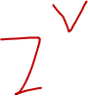
Independent set
Independent-Set. Given a graph G = (V, E) and an integer k, is there a subset of k (or more) vertices such that no two are adjacent?
Ex. Is there an independent set of size ≥ 6 ?
Ex. Is there an independent set of size ≥ 7 ?
independent set of size 6
Notes:
Scheduling application: an edge corresponds to a conflict. Find set of mutually non-conflicting jobs.

Slide 13
Vertex cover
Vertex-Cover. Given a graph G = (V, E) and an integer k, is there a subset of k (or fewer) vertices such that each edge is incident to at least one vertex in the subset?
Ex. Is there a vertex cover of size ≤ 4 ?
Ex. Is there a vertex cover of size ≤ 3 ?
independent set of size 6
vertex cover of size 4
Notes:
Toy application = art gallery problem: place guards within an art gallery so that all corridors are visible at any time

Slide 14

Intractability: quiz 2
Consider the following graph G. Which are true?
The white vertices are a vertex cover of size 7.
The black vertices are an independent set of size 3.
Both A and B.
Neither A nor B.

Slide 15
Vertex cover and independent set reduce to one another
Theorem. Independent-Set ≡ _{P} Vertex-Cover.
Pf. We show S is an independent set of size k iff V − S is a vertex cover of size n – k.
independent set of size 6
vertex cover of size 4
Notes:
V - S = complement

Slide 16

Vertex cover and independent set reduce to one another
Theorem. Independent-Set ≡ _{P} Vertex-Cover.
Pf. We show S is an independent set of size k iff V − S is a vertex cover of size n – k. ⇒
Let S be any independent set of size k.
V − S is of size n – k.
Consider an arbitrary edge (u, v) ∈ E.
S independent ⇒ either u ∉ S, or v ∉ S, or both.
⇒ either u ∈ V − S, or v ∈ V − S, or both.
Thus, V − S covers (u, v). ▪

Slide 17
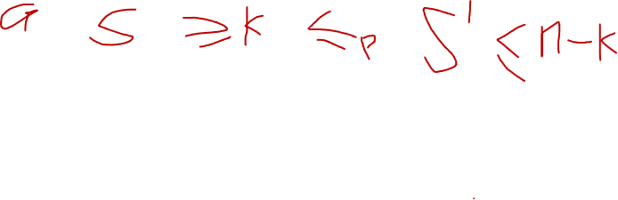
Vertex cover and independent set reduce to one another
Theorem. Independent-Set ≡ _{P} Vertex-Cover.
Pf. We show S is an independent set of size k iff V − S is a vertex cover of size n – k. ⇐
Let V − S be any vertex cover of size n – k.
S is of size k.
Consider an arbitrary edge (u, v) ∈ E.
V − S is a vertex cover ⇒ either u ∈ V − S, or v ∈ V − S, or both.
⇒ either u ∉ S, or v ∉ S, or both.
Thus, S is an independent set. ▪

Slide 18
Set cover
Set-Cover. Given a set U of elements, a collection S of subsets of U, and an integer k, are there ≤ k of these subsets whose union is equal to U ?
Sample application.
m available pieces of software.
Set U of n capabilities that we would like our system to have.
The i^{th} piece of software provides the set S_{i} ⊆ U of capabilities.
Goal: achieve all n capabilities using fewest pieces of software.
U = { 1, 2, 3, 4, 5, 6, 7 }
S_{a} = { 3, 7 } S_{b} = { 2, 4 }
S_{c} = { 3, 4, 5, 6 } S_{d} = { 5 } S_{e} = { 1 } S_{f} = { 1, 2, 6, 7 }
k = 2
a set cover instance

Slide 19
Intractability: quiz 3
Given the universe U = { 1, 2, 3, 4, 5, 6, 7 } and the following sets, which is the minimum size of a set cover?
1
2
3
None of the above.
U = { 1, 2, 3, 4, 5, 6, 7 }
S_{a} = { 1, 4, 6 } S_{b} = { 1, 6, 7 }
S_{c} = { 1, 2, 3, 6 } S_{d} = { 1, 3, 5, 7 } S_{e} = { 2, 6, 7 } S_{f} = { 3, 4, 5 }

Slide 20
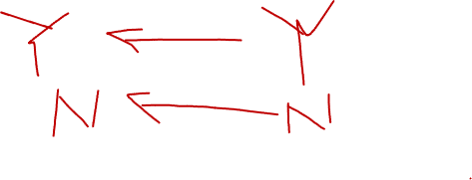
Vertex cover reduces to set cover
Theorem. Vertex-Cover ≤ _{P} Set-Cover.
Pf. Given a Vertex-Cover instance G = (V, E) and k, we construct a Set-Cover instance (U, S, k) that has a set cover of size k iff G has a vertex cover of size k.
Construction.
Universe U = E.
Include one subset for each node v ∈ V : S_{v} = {e ∈ E : e incident to v }.
a
b
U = { 1, 2, 3, 4, 5, 6, 7 }
S_{a} = { 3, 7 } S_{b} = { 2, 4 }
S_{c} = { 3, 4, 5, 6 } S_{d} = { 5 } S_{e} = { 1 } S_{f} = { 1, 2, 6, 7 }
e₇
e₂
e₃
e₄
f
e₆
c
e₁
e₅
e
d
vertex cover instance (k = 2)
set cover instance
(k = 2)
Notes:
special case of set cover because every element appears in exactly two sets

Slide 21
Vertex cover reduces to set cover
Lemma. G = (V, E) contains a vertex cover of size k iff (U, S, k) contains a set cover of size k.
Pf. ⇒ Let X ⊆ V be a vertex cover of size k in G.
Then Y = { Sv : v ∈ X } is a set cover of size k. ▪
“yes” instances of Vertex-Cover
are solved correctly
a
b
U = { 1, 2, 3, 4, 5, 6, 7 }
S_{a} = { 3, 7 } S_{b} = { 2, 4 }
S_{c} = { 3, 4, 5, 6 } S_{d} = { 5 } S_{e} = { 1 } S_{f} = { 1, 2, 6, 7 }
e₇
e₂
e₃
e₄
c
f
c
f
f
e₆
e₁
e₅
e
d
vertex cover instance (k = 2)
set cover instance
(k = 2)

Slide 22
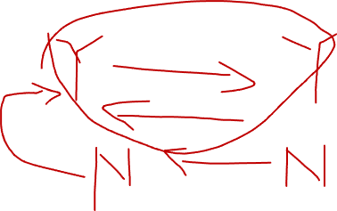
Vertex cover reduces to set cover
Lemma. G = (V, E) contains a vertex cover of size k iff (U, S, k) contains a set cover of size k.
Pf. ⇐ Let Y ⊆ S be a set cover of size k in (U, S, k).
Then X = { v : Sv ∈ Y } is a vertex cover of size k in G. ▪
“no” instances of Vertex-Cover
are solved correctly
a
b
U = { 1, 2, 3, 4, 5, 6, 7 }
S_{a} = { 3, 7 } S_{b} = { 2, 4 }
S_{c} = { 3, 4, 5, 6 } S_{d} = { 5 } S_{e} = { 1 } S_{f} = { 1, 2, 6, 7 }
e₇
e₂
e₃
e₄
c
f
c
f
f
e₆
e₁
e₅
e
d
vertex cover instance (k = 2)
set cover instance
(k = 2)

Slide 23
Reductions, P and NP
poly-time reductions
packing and covering problems
constraint satisfaction problems
graph coloring
P vs. NP
NP-complete
Section 8.2

Slide 24
Satisfiability
Literal. A Boolean variable or its negation.
Clause. A disjunction of literals.
Conjunctive normal form (CNF). A propositional formula Φ that is a conjunction of clauses.
Sat. Given a CNF formula Φ, does it have a satisfying truth assignment?
3-Sat. SAT where each clause contains exactly 3 literals (and each literal corresponds to a different variable).
Key application. Electronic design automation (EDA).
yes instance: x₁ = true, x₂ = true, x₃ = false, x₄ = false
Notes:
Any logical formula can be expressed in CNF.
, automatic verification systems for software, mean field diluted spin glass model in physics, ….

Slide 25
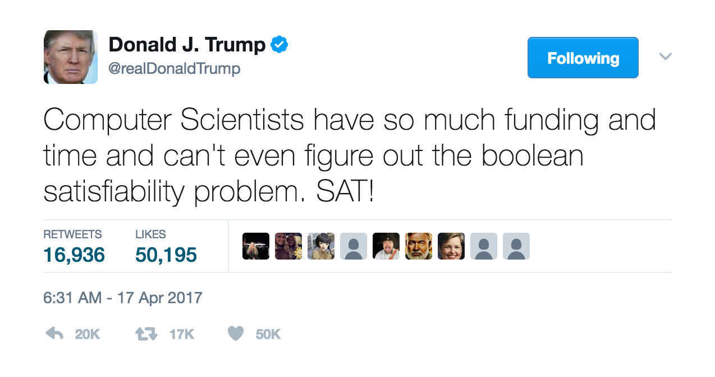
Satisfiability is hard
Scientific hypothesis. There does not exists a poly-time algorithm for 3-Sat.
P vs. NP. This hypothesis is equivalent to P ≠ NP conjecture.
https://www.facebook.com/pg/npcompleteteens
Notes:
https://thorehusfeldt.wordpress.com/2017/12/05/np-is-wrong/

Slide 26
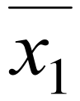
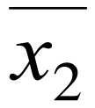
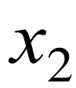
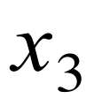
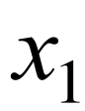
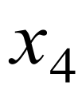
3-satisfiability reduces to independent set
Theorem. 3-Sat ≤ P Independent-Set.
Pf. Given an instance Φ of 3-Sat, we construct an instance (G, k) of Independent-Set that has an independent set of size k = ⎜Φ⎜ iff Φ is satisfiable.
Construction.
G contains 3 nodes for each clause, one for each literal.
Connect 3 literals in a clause in a triangle.
Connect literal to each of its negations.
G
k = 3

Slide 27
3-satisfiability reduces to independent set
Lemma. Φ is satisfiable iff G contains an independent set of size k = |Φ|.
Pf. ⇒ Consider any satisfying assignment for Φ.
Select one true literal from each clause/triangle.
This is an independent set of size k = |Φ|. ▪
“yes” instances of 3-Sat
are solved correctly
G
k = 3

Slide 28
3-satisfiability reduces to independent set
Lemma. Φ is satisfiable iff G contains an independent set of size k = |Φ|.
Pf. ⇐ Let S be independent set of size k.
S must contain exactly one node in each triangle.
Set these literals to true (and remaining literals consistently).
All clauses in Φ are satisfied. ▪
“no” instances of 3-Sat
are solved correctly
G
k = 3

Slide 29
Review
Basic reduction strategies.
Simple equivalence: Independent-Set ≡ _{P} Vertex-Cover.
Special case to general case: Vertex-Cover ≤ _{P} Set-Cover.
Encoding with gadgets: 3-Sat ≤ _{P} Independent-Set.
Transitivity. If X ≤ _{P} Y and Y ≤ _{P} Z, then X ≤ _{P} Z.
Pf idea. Compose the two algorithms.
Ex. 3-Sat ≤ _{P} Independent-Set ≤ _{P} Vertex-Cover ≤ _{P} Set-Cover.
Notes:
Proof idea for transitivity: compose the two algorithms.
Given an oracle for Z, can solve instance of X:
run the algorithm for X using a oracle for Y
each time oracle for Y is called, simulate it in a polynomial number of steps by using algorithm for Y, plus oracle calls to Z

Slide 30


Decision, search, and optimization problems
Decision problem. Does there exist a vertex cover of size ≤ k ?
Search problem. Find a vertex cover of size ≤ k.
Optimization problem. Find a vertex cover of minimum size.
Goal. Show that all three problems poly-time reduce to one another.

Slide 31

Search problems vs. decision problems
Vertex-Cover. Does there exist a vertex cover of size ≤ k ?
Find-Vertex-Cover. Find a vertex cover of size ≤ k.
Theorem. Vertex-Cover ≡ _{P} Find-Vertex-Cover.
Pf. ≤ _{P} Decision problem is a special case of search problem. ▪
Pf. ≥ _{P}
To find a vertex cover of size ≤ k :
Determine if there exists a vertex cover of size ≤ k.
Find a vertex v such that G − { v } has a vertex cover of size ≤ k − 1. (any vertex in any vertex cover of size ≤ k will have this property)
Include v in the vertex cover.
Recursively find a vertex cover of size ≤ k − 1 in G − { v }. ▪
delete v and all incident edges
Notes:
not explicitly covered in book, but justifies our focus on decision problems instead of search problems
more generally, all np-complete problems are self-reducible
for more examples: http://www.cs.toronto.edu/~fpitt/CSC363/20081/lectures/LN11.txt
Self-reducibility. Search problem ≤ P decision version.
Applies to all (NP-complete) problems in this chapter.
Justifies our focus on decision problems.

Slide 32

Optimization problems vs. search problems
Find-Vertex-Cover. Find a vertex cover of size ≤ k.
Find-Min-Vertex-Cover. Find a vertex cover of minimum size.
Theorem. Find-Vertex-Cover ≡ _{P} Find-Min-Vertex-Cover.
Pf. ≤ _{P} Search problem is a special case of optimization problem. ▪
Pf. ≥ _{P} To find vertex cover of minimum size:
Binary search (or linear search) for size k* of min vertex cover.
Solve search problem for given k*. ▪

Slide 33
Reductions, P and NP
poly-time reductions
packing and covering problems
constraint satisfaction problems
graph coloring
P vs. NP
NP-complete
Section 8.7

Slide 34
3-colorability
3-Color. Given an undirected graph G, can the nodes be colored black, white, and blue so that no adjacent nodes have the same color?
yes instance

Slide 35

Intractability: quiz 4
How difficult to solve 2-Color?
O(m + n) using BFS or DFS.
O(mn) using maximum flow.
Ω(2^{n}) using brute force.
Not even Tarjan knows.
Notes:
not 2-colorable - there is a cycle of length 7 (odd) and 9

Slide 36
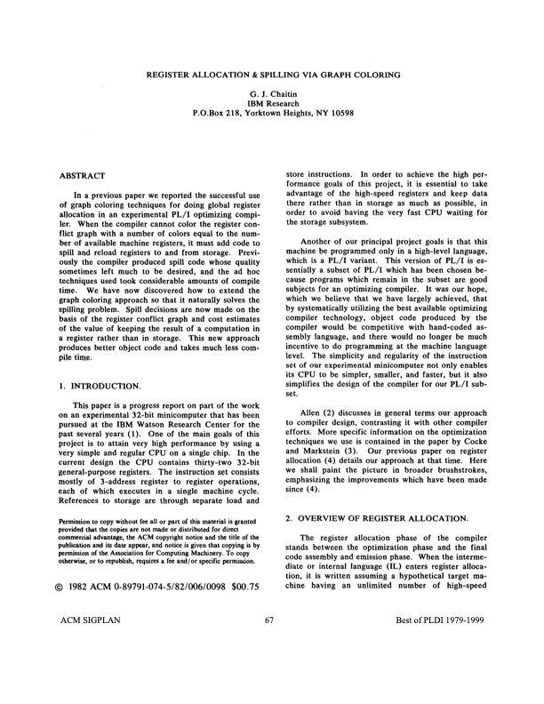
Application: register allocation
Register allocation. Assign program variables to machine registers so that no more than k registers are used and no two program variables that are needed at the same time are assigned to the same register.
Interference graph. Nodes are program variables; edge between u and v if there exists an operation where both u and v are “live” at the same time.
Observation. [Chaitin 1982] Can solve register allocation problem iff interference graph is k-colorable.
Fact. 3-Color ≤ _{P} K-Register-Allocation for any constant k ≥ 3.
Notes:
Note: in general, interference graph is arbitrary so 3-color is equivalent to 3-register allocation. For many applications, interference graph is chordal (which can be solved in polynomial time)

Slide 37

3-satisfiability reduces to 3-colorability
Theorem. 3-Sat ≤ _{P} 3-Color.
Pf. Given 3-Sat instance Φ, we construct an instance of 3-Color that is 3-colorable iff Φ is satisfiable.

Slide 38
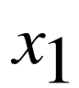
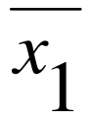
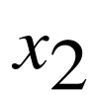
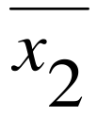
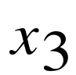
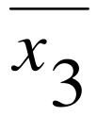
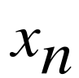
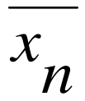
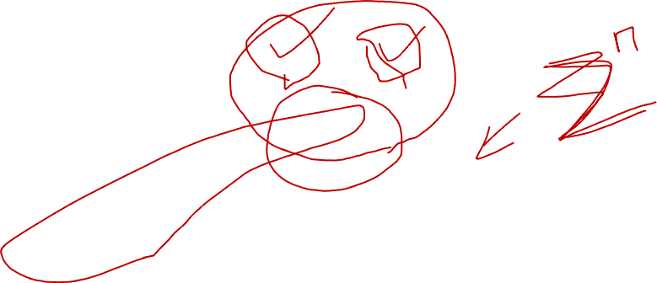
3-satisfiability reduces to 3-colorability
Construction.
Create a graph G with a node for each literal.
Connect each literal to its negation.
Create 3 new nodes T, F, and B; connect them in a triangle.
Connect each literal to B.
For each clause Cj, add a gadget of 6 nodes and 13 edges.
to be described later
T
F
B

Slide 39
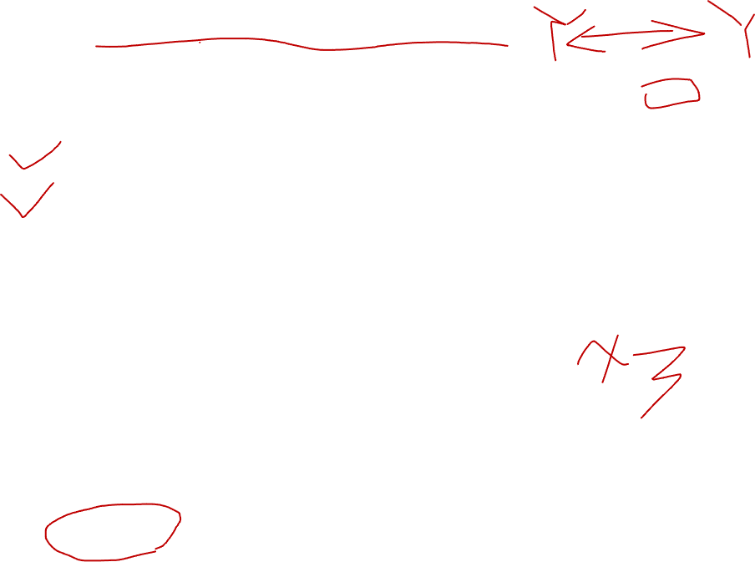
3-satisfiability reduces to 3-colorability
Lemma. Graph G is 3-colorable iff Φ is satisfiable.
Pf. ⇒ Suppose graph G is 3-colorable.
WLOG, assume that node T is colored black, F is white, and B is blue.
Consider assignment that sets all black literals to true (and white to false).
(iv) ensures each literal is colored either black or white.
(ii) ensures that each literal is white if its negation is black (and vice versa).
true
false
T
T
F
F
base
B
B

Slide 40

3-satisfiability reduces to 3-colorability
Lemma. Graph G is 3-colorable iff Φ is satisfiable.
Pf. ⇒ Suppose graph G is 3-colorable.
WLOG, assume that node T is colored black, F is white, and B is blue.
Consider assignment that sets all black literals to true (and white to false).
(iv) ensures each literal is colored either black or white.
(ii) ensures that each literal is white if its negation is black (and vice versa).
(v) ensures at least one literal in each clause is black.
B
6-node gadget
true
T
F
false
Notes:
6 nodes,13 edges

Slide 41
3-satisfiability reduces to 3-colorability
Lemma. Graph G is 3-colorable iff Φ is satisfiable.
Pf. ⇒ Suppose graph G is 3-colorable.
WLOG, assume that node T is colored black, F is white, and B is blue.
Consider assignment that sets all black literals to true (and white to false).
(iv) ensures each literal is colored either black or white.
(ii) ensures that each literal is white if its negation is black (and vice versa).
(v) ensures at least one literal in each clause is black. ▪
suppose, for the sake of contradiction,
that all 3 literals are white in some 3-coloring
B
contradiction
(not a 3-coloring)
true
T
💣
F
false

Slide 42
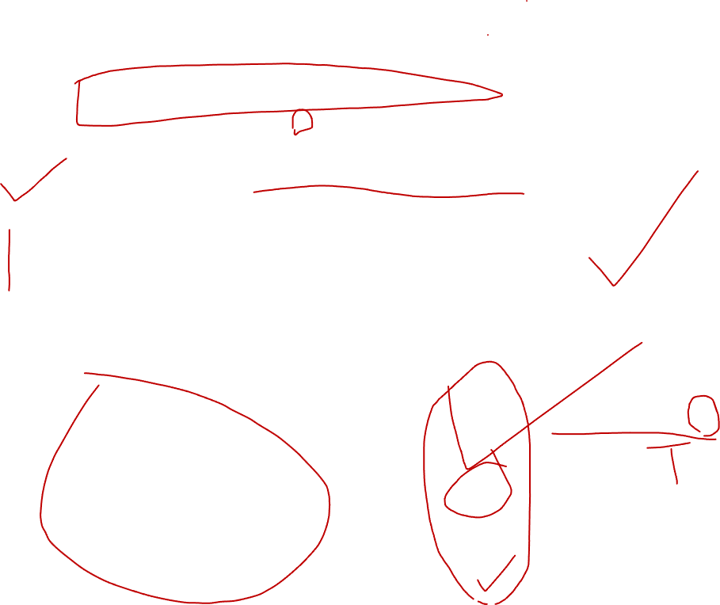
3-satisfiability reduces to 3-colorability
Lemma. Graph G is 3-colorable iff Φ is satisfiable.
Pf. ⇐ Suppose 3-Sat instance Φ is satisfiable.
Color all true literals black and all false literals white.
Pick one true literal; color node below that node white, and node below that blue.
Color remaining middle row nodes blue.
Color remaining bottom nodes black or white, as forced. ▪
a literal set to true
in 3-SAT assignment
B
x3
true
T
F
false

Slide 43

Poly-time reductions
constraint satisfaction
3-Sat
3-Sat poly-time reduces
to Independent-Set
Independent-Set
Dir-Ham-Cycle
3-Color
Subset-Sum
Vertex-Cover
Ham-Cycle
Knapsack
Set-Cover
packing and covering
sequencing
partitioning
numerical

Slide 44
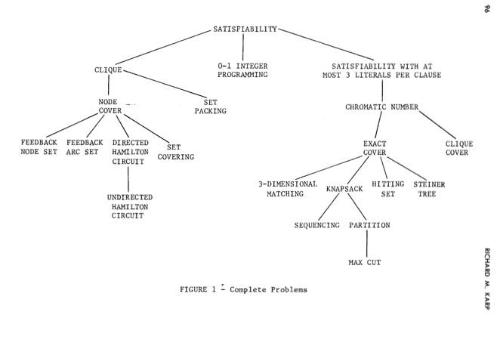
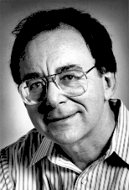
Karp’s 20 poly-time reductions from satisfiability
Dick Karp (1972) 1985 Turing Award
Notes:
Karp analyzed most juicy open problem in discrete math – showed most were NP-complete
x -> y means x reduces to y (if you can solve y, then you can solve x)
Then to join the NP-complete club, you need a reduction from SAT (or any other current member) to you

Slide 45
Reductions, P and NP
poly-time reductions
packing and covering problems
constraint satisfaction problems
graph coloring
P vs. NP
NP-complete
Section 8.3

Slide 46
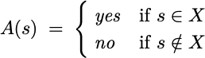
P
Decision problem.
Problem X is a set of strings.
Instance s is one string.
Algorithm A solves problem X :
Def. Algorithm A runs in polynomial time if for every string s, A(s) terminates in ≤ p( ⎢s⎢) “steps,” where p(⋅) is some polynomial function.
Def. P = set of decision problems for which there exists a poly-time algorithm.
length of s
on a deterministic
Turing machine
problem PRIMES: { 2, 3, 5, 7, 11, 13, 17, 19, 23, 29, 31, … }
instance s: 592335744548702854681
algorithm: Agrawal–Kayal–Saxena (2002)
Notes:
A(s) \; = \;
\begin{cases}
\; \text{\em yes} & \text{if $s \in X$} \\
\; \text{\em no} & \text{if $s \notin X$}
\end{cases}

Slide 47
NP
Def. Algorithm C(s, t) is a certifier for problem X if for every string s : s ∈ X iff there exists a string t such that C(s, t) = yes.
Def. NP = set of decision problems for which there exists a poly-time certifier.
C(s, t) is a poly-time algorithm.
Certificate t is of polynomial size: ⎢t⎢ ≤ p(⎢s⎢) for some polynomial p(⋅).
“certificate” or “witness”
problem COMPOSITES: { 4, 6, 8, 9, 10, 12, 14, 15, 16, 18, 20, …. }
instance s: 437669
certificate t: 541
certifier C(s, t): grade-school division
437,669 = 541 × 809
Notes:
Certifier views things from “managerial" viewpoint.
Certifier doesn’t determine whether s ∈ X on its own; rather, it checks a proposed proof t that s ∈ X.
Note: only yes instances need certificates.

Slide 48
Certifiers and certificates: satisfiability
Sat. Given a CNF formula Φ, does it have a satisfying truth assignment?
3-Sat. Sat where each clause contains exactly 3 literals.
Certificate. An assignment of truth values to the Boolean variables.
Certifier. Check that each clause in Φ has at least one true literal.
Conclusions. Sat ∈ NP, 3-Sat ∈ NP.
instance s
certificate t
x1 = true, x2 = true, x3 = false, x4 = false

Slide 49
Intractability: quiz 5
Which of the following graph problems are known to be in NP?
Is the length of the longest simple path ≤ k ?
Is the length of the longest simple path ≥ k ?
Is the length of the longest simple path = k ?
Find the length of the longest simple path.
All of the above.

Slide 50
Intractability: quiz 6
In complexity theory, the abbreviation NP stands for…
Nope.
No problem.
Not polynomial time.
Not polynomial space.
Nondeterministic polynomial time.

Slide 51
Significance of NP
NP. Decision problems for which there exists a poly-time certifier.
“ NP captures vast domains of computational, scientific, and mathematical endeavors, and seems to roughly delimit what mathematicians and scientists have been aspiring to compute feasibly. ” — Christos Papadimitriou
“ In an ideal world it would be renamed P vs VP. ” — Clyde Kruskal

Slide 52
P, NP, and EXP
P. Decision problems for which there exists a poly-time algorithm.
NP. Decision problems for which there exists a poly-time certifier.
EXP. Decision problems for which there exists an exponential-time algorithm.
Proposition. P ⊆ NP.
Pf. Consider any problem X ∈ P.
By definition, there exists a poly-time algorithm A(s) that solves X.
Certificate t = ε, certifier C(s, t) = A(s). ▪
Proposition. NP ⊆ EXP.
Pf. Consider any problem X ∈ NP.
By definition, there exists a poly-time certifier C(s, t) for X, where certificate t satisfies ⎢t⎢ ≤ p(⎢s⎢) for some polynomial p(⋅).
To solve instance s, run C(s, t) on all strings t with ⎢t⎢ ≤ p(⎢s⎢).
Return yes iff C(s, t) returns yes for any of these potential certificates. ▪
Fact. P ≠ EXP ⇒ either P ≠ NP, or NP ≠ EXP, or both.
Notes:
epsilon = empty string
Remark. Time-hierarchy theorem implies P ⊊ EXP.

Slide 53
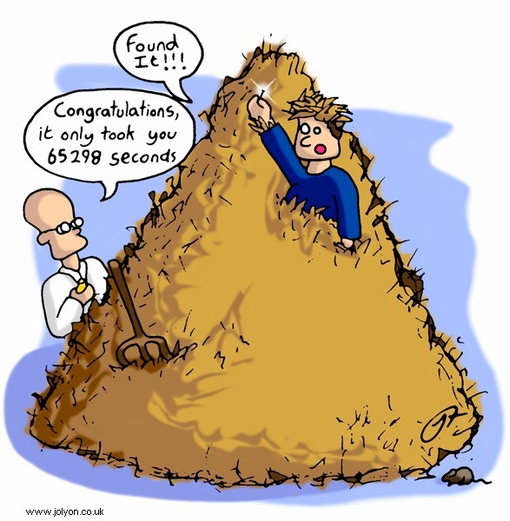
The main question: P vs. NP
Q. How to solve an instance of 3-Sat with n variables?
A. Exhaustive search: try all 2^{n} truth assignments.
Q. Can we do anything substantially more clever?
Conjecture. No poly-time algorithm for 3-Sat.
“intractable”

Slide 54
The main question: P vs. NP
Does P = NP? [Cook 1971, Edmonds, Levin, Yablonski, Gödel] Is the decision problem as easy as the certification problem?
If yes… Efficient algorithms for 3-Sat, TSP, Vertex-Cover, Factor, …
If no… No efficient algorithms possible for 3-Sat, TSP, Vertex-Cover, …
Consensus opinion. Probably no.
EXP
EXP
NP
P = NP
P
If P = NP
If P ≠ NP
Notes:
Cook formulated conjecture explicitly, others presented close approximations
“ The classes of problems which are respectively known and not known to have good algorithms are of great theoretical interest….
If no, then computer scientists can say "I told you so"

Slide 55
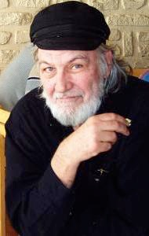
Possible outcomes
P ≠ NP
“ I conjecture that there is no good algorithm for the traveling salesman
problem. My reasons are the same as for any mathematical conjecture: (i) It is a legitimate mathematical possibility and (ii) I do not know.”
— Jack Edmonds 1966
“ In my view, there is no way to even make intelligent guesses about the
answer to any of these questions. If I had to bet now, I would bet that
P is not equal to NP. I estimate the half-life of this problem at 25–50
more years, but I wouldn’t bet on it being solved before 2100. ”
— Bob Tarjan (2002)

Slide 56
Possible outcomes
P ≠ NP
“ We seem to be missing even the most basic understanding of the
nature of its difficulty…. All approaches tried so far probably (in some cases, provably) have failed. In this sense P =NP is different
from many other major mathematical problems on which a gradual
progress was being constantly done (sometimes for centuries)
whereupon they yielded, either completely or partially. ”
— Alexander Razborov (2002)
Notes:
/~gasarch/papers/poll.pdf
https://commons.wikimedia.org/wiki/File:Bob_Tarjan.jpg
GNU Free Documentation License, Version 1.2 or any later version

Slide 57
Possible outcomes
P = NP
“ I think that in this respect I am on the loony fringe of the mathematical
community: I think (not too strongly!) that P=NP and this will be
proved within twenty years. Some years ago, Charles Read and I
worked on it quite bit, and we even had a celebratory dinner in a
good restaurant before we found an absolutely fatal mistake. ” — Béla Bollobás (2002)
“ In my opinion this shouldn’t really be a hard problem; it’s just
that we came late to this theory, and haven’t yet developed any
techniques for proving computations to be hard. Eventually, it will
just be a footnote in the books. ” — John Conway

Slide 58
Other possible outcomes
P = NP, but only Ω(n¹⁰⁰) algorithm for 3-Sat.
P ≠ NP, but with O(n^{log*n}) algorithm for 3-Sat.
P = NP is independent (of ZFC axiomatic set theory).
“ It will be solved by either 2048 or 4096. I am currently somewhat
pessimistic. The outcome will be the truly worst case scenario:
namely that someone will prove P = NP because there are only
finitely many obstructions to the opposite hypothesis; hence there
exists a polynomial time solution to SAT but we will never know its complexity! ” — Donald Knuth
Notes:
https://commons.wikimedia.org/wiki/File:KnuthAtOpenContentAlliance.jpg
Creative Commons Attribution-Share Alike 2.5 Generic

Slide 59
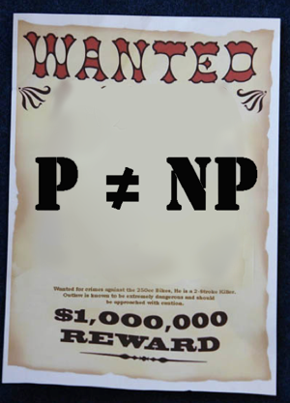
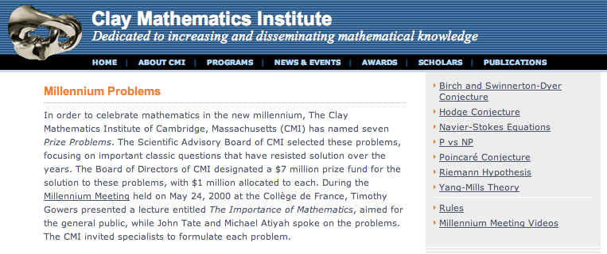
Millennium prize
Millennium prize. $1 million for resolution of P ≠ NP problem.

Slide 60
Reductions, P and NP
poly-time reductions
packing and covering problems
constraint satisfaction problems
graph coloring
P vs. NP
NP-complete
Section 8.4

Slide 61
Polynomial transformations
Def. Problem X polynomial (Cook) reduces to problem Y if arbitrary instances of problem X can be solved using:
Polynomial number of standard computational steps, plus
Polynomial number of calls to oracle that solves problem Y.
Def. Problem X polynomial (Karp) transforms to problem Y if given any instance x of X, we can construct an instance y of Y such that x is a yes instance of X iff y is a yes instance of Y.
Note. Polynomial transformation is polynomial reduction with just one call to oracle for Y, exactly at the end of the algorithm for X. Almost all previous reductions were of this form.
Open question. Are these two concepts the same with respect to NP?
we require ⎢y⎢ to be of size polynomial in ⎢x⎢
we abuse notation ≤ _{P} and blur distinction
Notes:
Cook and Karp reductions are different (Richard E. Ladner, Nancy A. Lynch, Alan L. Selman: A Comparison of Polynomial Time Reducibilities. Theoretical Computer Science 1(2): 103-123 (1975)).
If Cook reduction = Karp reduction then co-NP = NP; if Cook reduction != Karp reduction, then P != NP.
Difference between Cook and Karp: with Cook, you get to the oracle more than once and you can even call it adaptively (based on results of previous oracle calls)

Slide 62
NP-complete
NP-complete. A problem Y ∈ NP with the property that for every problem X ∈ NP, X ≤ _{P} Y.
Proposition. Suppose Y ∈ NP-complete. Then, Y ∈ P iff P = NP.
Pf. ⇐ If P = NP, then Y ∈ P because Y ∈ NP.
Pf. ⇒ Suppose Y ∈ P.
Consider any problem X ∈ NP. Since X ≤ P Y, we have X ∈ P.
This implies NP ⊆ P.
We already know P ⊆ NP. Thus P = NP. ▪
Fundamental question. Are there any “natural” NP-complete problems?
Notes:
why couldn't there be incomparable problems such that neither X <= Y nor Y <= X ?

Slide 63
Circuit satisfiability
Circuit-Sat. Given a combinational circuit built from and, or, and not gates, is there a way to set the circuit inputs so that the output is 1?
output
∧
¬
∧
yes: 1 0 1
∧
∨
∨
1
0
?
?
?
hard-coded inputs
variable inputs
Notes:
combinatorial circuit = DAG

Slide 64
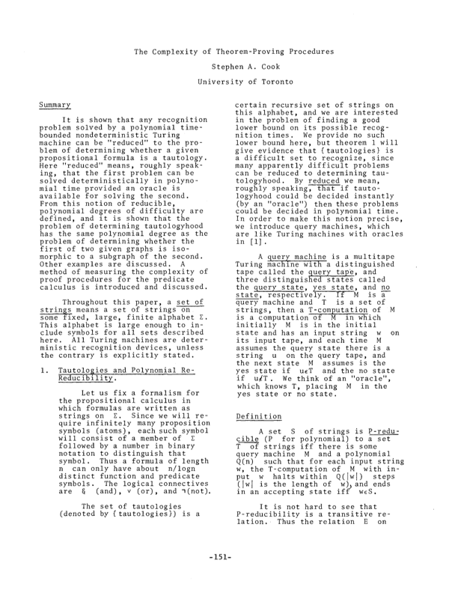
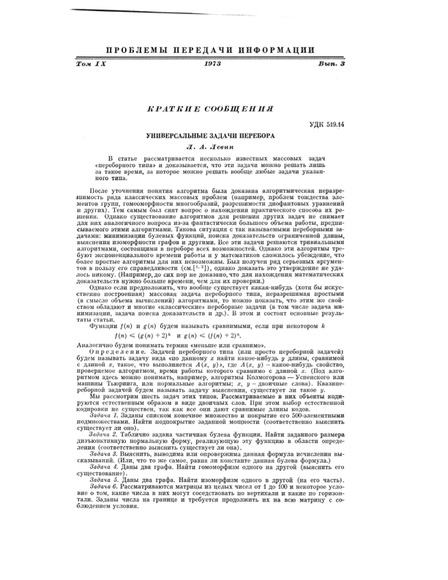
The “first” NP-complete problem
Theorem. Circuit-Sat ∈ NP-complete. [Cook 1971, Levin 1973]
Notes:
intellectual milestone in CS
by Savage's theorem, P = languages with uniformly polynomial circuits

Slide 65
The “first” NP-complete problem
Theorem. [Cook 1971, Levin 1973] Sat ∈ NP-complete.
Notes:
intellectual milestone in CS
by Savage's theorem, P = languages with uniformly polynomial circuits

Slide 66
The “first” NP-complete problem
Theorem. Circuit-Sat ∈ NP-complete.
Pf sketch.
Clearly, Circuit-Sat ∈ NP.
Any algorithm that takes a fixed number of bits n as input and produces a yes or no answer can be represented by such a circuit.
Moreover, if algorithm takes poly-time, then circuit is of poly-size.
Consider any problem X ∈ NP. It has a poly-time certifier C(s, t), where certificate t satisfies | t | ≤ p( | s | ) for some polynomial p(⋅).
View C(s, t) as an algorithm with | s | + p(| s |) input bits and convert it into a poly-size circuit K.
first | s | bits are hard-coded with s
remaining p(| s |) bits represent (unknown) bits of t
Circuit K is satisfiable iff C(s, t) = yes.
sketchy part of proof; fixing the number of bits is important, and reflects basic distinction between algorithms and circuits
Notes:
[could also do formal "first" NP-completeness proof based on Turing machines]
intellectual milestone in CS
A poly-size circuit family is a circuit C_n for each input size n that has <= n^k + k gates.
Theorem 1.2. P subset P / poly. Every time t(n) algorithm can be simulated on a circuit of size O(t(n)^c) for some constant c depending on model of computation.
http://www.stanford.edu/~rrwill/week3.pdf
[ by Savage's theorem, P = languages with uniformly polynomial circuits ]

Slide 67
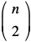
Example
Ex. Construction below creates a circuit K whose inputs can be set so that it outputs 1 iff graph G has an independent set of size 2.
∧
independent set of size 2?
independent set?
¬
both endpoints of some
edge have been chosen?
∨
∨
set of size 2?
∨
∧
∧
∧
∨
u
∧
∧
∧
v
w
G = (V, E), n = 3
u-v
u-w
v-w
u
v
w
1
0
1
?
?
?
hard-coded inputs
(graph description)
n inputs
(nodes in independent set)

Slide 68
Establishing NP-completeness
Remark. Once we establish first “natural” NP-complete problem, others fall like dominoes.
Recipe. To prove that Y ∈ NP-complete:
Step 1. Show that Y ∈ NP.
Step 2. Choose an NP-complete problem X.
Step 3. Prove that X ≤ _{P} Y.
Proposition. If X ∈ NP-complete, Y ∈ NP, and X ≤ _{P} Y, then Y ∈ NP-complete.
Pf. Consider any problem W ∈ NP. Then, both W ≤ _{P} X and X ≤ _{P} Y.
By transitivity, W ≤ _{P} Y.
Hence Y ∈ NP-complete. ▪
by definition of NP-complete
by assumption

Slide 69
Reductions: quiz 7
Suppose that X ∈ NP-Complete, Y ∈ NP, and X ≤ _{P} Y. Which can you infer?
Y is NP-complete.
If Y ∉ P, then P ≠ NP.
If P ≠ NP, then neither X nor Y is in P.
All of the above.
recipe for proving that Y is NP-complete
Y is NP-complete
X and Y are NP-complete
Notes:
B and C: recall If Y is NP-complete, then Y is in P iff P = NP.

Slide 70
3-satisfiability is NP-complete
Theorem. 3-Sat ∈ NP-complete.
Pf.
Suffices to show that Circuit-Sat ≤ P 3-Sat since 3-Sat ∈ NP.
Given a combinational circuit K, we construct an instance Φ of 3-Sat that is satisfiable iff the inputs of K can be set so that it outputs 1.

Slide 71
3-satisfiability is NP-complete
Construction. Let K be any circuit.
Step 1. Create a 3-Sat variable xi for each circuit element i.
Step 2. Make circuit compute correct values at each node:
x2 = ¬ x3 ⇒ add 2 clauses:
x1 = x4 ∨ x5 ⇒ add 3 clauses:
x0 = x1 ∧ x2 ⇒ add 3 clauses:
Step 3. Hard-coded input values and output value.
x5 = 0 ⇒ add 1 clause:
x0 = 1 ⇒ add 1 clause:
x₀
∧
x₁
∨
¬
x₂
x₅
x₄
x₃
0
?
?

Slide 72
3-satisfiability is NP-complete
Construction. [continued]
Step 4. Turn clauses of length 1 or 2 into clauses of length 3.
Create four new variables z1, z2, z3, and z4.
Add 8 clauses to force z1 = z2 = 0:
Replace any clause with a single term ( ti ) with ( ti ∨ z1 ∨ z2 ).
Replace any clause with two terms ( ti ∨ tj ) with ( ti ∨ tj ∨ z1 ).
Notes:
(\overline{z_1} \; \lor \; {z_3} \; \lor \; {z_4}), \;\;
(\overline{z_1} \; \lor \; {z_3} \; \lor \; \overline{z_4}), \;\;
(\overline{z_1} \; \lor \; \overline{z_3} \; \lor \; {z_4}), \;\;
(\overline{z_1} \; \lor \; \overline{z_3} \; \lor \; \overline{z_4}) \\
(\overline{z_2} \; \lor \; {z_3} \; \lor \; {z_4}), \;\;
(\overline{z_2} \; \lor \; {z_3} \; \lor \; \overline{z_4}), \;\;
(\overline{z_2} \; \lor \; \overline{z_3} \; \lor \; {z_4}), \;\;
(\overline{z_2} \; \lor \; \overline{z_3} \; \lor \; \overline{z_4})

Slide 73
3-satisfiability is NP-complete
Lemma. Φ is satisfiable iff the inputs of K can be set so that it outputs 1. Pf. ⇐ Suppose there are inputs of K that make it output 1.
Can propagate input values to create values at all nodes of K.
This set of values satisfies Φ.
Pf. ⇒ Suppose Φ is satisfiable.
We claim that the set of values corresponding to the circuit inputs constitutes a way to make circuit K output 1.
The 3-Sat clauses were designed to ensure that the values assigned to all node in K exactly match what the circuit would compute for these nodes. ▪
x₀
∧
x₁
∨
¬
x₂
x₅
x₄
x₃
0
?
?

Slide 74
Implications of Karp
Sat
3-Sat
3-Sat poly-time reduces to Independent-Set
Independent-Set
Dir-Ham-Cycle
3-Color
Subset-Sum
Vertex-Cover
Ham-Cycle
Knapsack
Sat poly-time reduces to all of
these problems (and many, many more)
Set-Cover

Slide 75
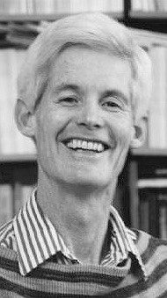
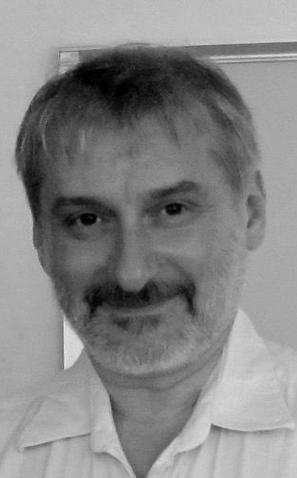
Implications of Cook–Levin
Sat
Independent-Set poly-time reduces to Circuit-Sat
3-Sat
Independent-Set
Dir-Ham-Cycle
3-Color
Subset-Sum
Vertex-Cover
Ham-Cycle
Knapsack
All of these problems (and many, many more)
poly-time reduce to Sat.
Set-Cover

Slide 76
Implications of Karp + Cook–Levin
Sat
3-Sat and Independent-Set poly-time reduce to one another
3-Sat
Independent-Set
Dir-Ham-Cycle
3-Color
Subset-Sum
Vertex-Cover
Ham-Cycle
Knapsack
All of these problems are NP-complete; they are manifestations of the same really hard problem.
Set-Cover

